Slide 1
Manual and Load Testing

Slide 2
What is load Testing Load Testing is a subset of Performance Testing, where we test the system’s response under varying load conditions by simulating multiple users accessing the application concurrently. This testing usually measures the speed and capacity of the application.

Slide 3
Goals of Load Testing: a) Load testing identifies the following problems before moving the application to market or Production: b) Response time for each transaction c) Performance of System components under various loads d) Performance of Database components under different loads e) Network delay between the client and the server f) Software design issues g) Server configuration issues like a Web server, application server, database server etc. h) Hardware limitation issues like CPU maximization, memory limitations, network bottleneck, etc. Load testing will determine whether the system needs to be fine-tuned or modification of hardware and software is required to improve performance.

Slide 4
Load Testing based on the following calculations: 1) Transactions per hour = Number of users*Transactions made by a single user in one hour. 2) The number of users 3) The total number of transaction in the Browse scenario 4) Response Time for each transaction 5) The response time of the Login page shouldn’t be more than 5 sec even during the max load conditions. 6) CPU utilization should not be more than 80%. 7) The throughput of the system 8) Number application thread 9) Number of database pool size 10) Apache memory define

Slide 5
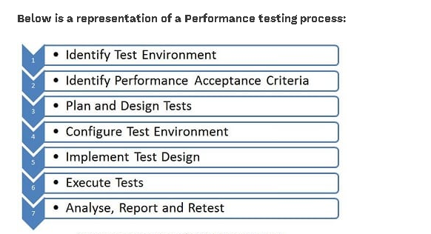

Slide 6
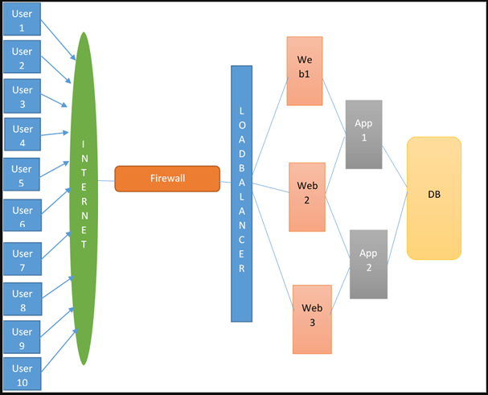
Basic Application Architecture

Slide 7
Shell Script for Load Testing
echo '#########################################' > scriptstatus.txt
echo “Load started @`date '+%d-%m-%Y %H:%M:S'`" >> scriptstatus.txt
dt=`date '+Y%m%d%H%M%S'`
file=customer_info_input file.txt
file2=customer_info_output_$dt.txt
for i in `cat $file`
do
####### posting xml for generating ssh key for secure connection
curl -k -s -user usr/pswd -header "Content-Type: text/xml;charset=UTF-8"--header "SOAPAction:POST"--data @sshkey.xml -X POST https:/127.0.0.1:port > sshkey.output
sshkey=`less sshkey.output | awk -F '' '{print $1}'
#######placing sshkey in main xml while calling api
echo "<?xml version envelope>$sshkey</soapenv:Envelope>" > mainapi.xml
###### Putting load in main API
curl -k -s -user usr/pswd -header "Content-Type: text/xml;charset=UTF-8"--header "SOAPAction:POST"--data @ mainapi.xml -X POST https:/127.0.0.1:port > mainapi.output
##### Grep status of each api response
sts='less mainapi.output | awk -F ' ' '{print $1}'
########putting status in txt file
echo "$i","$sts" >> $file2
Done
echo “Load Ended @`date '+%d-%m-%Y %H:%M:S'`" >> scriptstatus.txt
echo '#########################################' .> scriptstatus.txt

Slide 8
Thank you

